Slide 1
Micro services

Slide 2
What is Microservices?
Microservices is not a new term. It coined in 2005 by Dr Peter Rodgers
It was then called micro web services based on SOAP. It became more popular since 2010.
Micoservices allows us to break our large system into number of independent collaborating processes.

Slide 3
What is Microservices?
Microservices architecture allows to avoid monolith application for large system.
It provides loose coupling between collaborating processes running independently in different environments with tight cohesion.
It is an architectural style that structures an application as a collection of loosely coupled services, which implement business capabilities. The microservice architecture enables the continuous delivery/deployment of large, complex applications. It also enables an organization to evolve its technology stack.

Slide 4
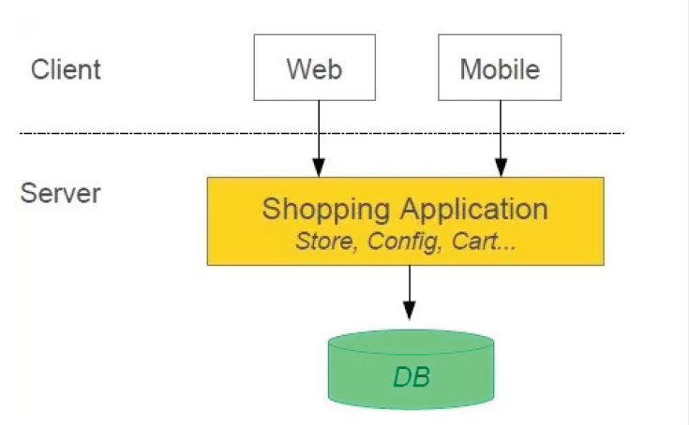
Example : Monolith Architecture
This is Monolith architecture i.e. all collaborating components combine all in one application.

Slide 5
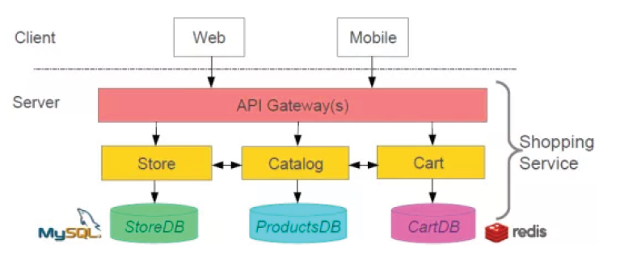
Example : Microservices Architecture
This is Microservices architecture , One large Application divided into multiple collaborating processes
Notes:
1. software built as microservices can, by definition, be broken down into multiple component services.
Why? So that each of these services can be deployed, tweaked, and then redeployed independently without compromising the integrity of an application.
As a result, you might only need to change one or more distinct services instead of having to redeploy entire applications. But this approach does have its downsides, including expensive remote calls (instead of in-process calls), coarser-grained remote APIs, and increased complexity when redistributing responsibilities between components.
2. the microservices style is usually organized around business capabilities and priorities.
Unlike a traditional monolithic development approach—where different teams each have a specific focus on, say, UIs, databases, technology layers, or server-side logic—microservice architecture utilizes cross-functional teams.
The responsibilities of each team are to make specific products based on one or more individual services communicating via message bus.
That means that when changes are required, there won’t necessarily be any reason for the project, as a whole, to take more time .
3. microservices act somewhat like the classical UNIX system: they receive requests, process them, and generate a response accordingly.
This is opposite to many other products such as ESBs (Enterprise Service Buses) work, where high-tech systems for message routing, choreography, and applying business rules are utilized.
You could say that microservices have smart endpoints that process info and apply logic.
4. since microservices involve a variety of technologies and platforms, old-school methods of centralized governance aren’t optimal.
Decentralized governance is favored by the microservices community because its developers strive to produce useful tools that can then be used by others to solve the same problems.
A practical example of this is Netflix—the service responsible for about 30% of traffic on the web.
The company encourages its developers to save time by always using code libraries established by others, while also giving them the freedom to flirt with alternative solutions when needed.
Just like decentralized governance, microservice architecture also favors decentralized data management.
Monolithic systems use a single logical database across different applications.
In a microservice application, each service usually manages its unique database.
5. like a well-rounded child, microservices are designed to cope with failure.
Since several unique and diverse services are communicating together, it’s quite possible that a service could fail, for one reason or another (e.g., when the supplier isn’t available).
In these instances, the client should allow its neighboring services to function while it bows out in as graceful a manner as possible.
For obvious reasons, this requirement adds more complexity to microservices as compared to monolithic systems architecture.
6. microservices architecture is an evolutionary design and, again, is ideal for evolutionary systems where you can’t fully anticipate the types of devices that may one day be accessing your application.
This is because the style’s practitioners see decomposition as a powerful tool that gives them control over application development.
Further explanation : file:///C:/Users/Ameya/Downloads/spring-boot/Microservice%20Architecture%20pattern.pdf

Slide 6
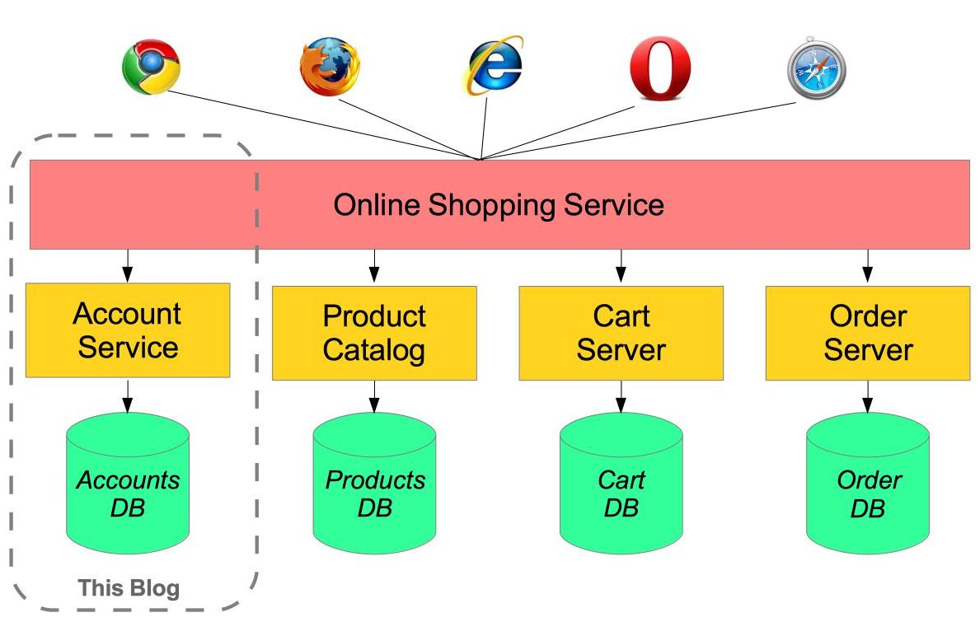
Example : Microservices Architecture

Slide 7
Microservices Challenges
Difficult to achieve strong consistency across services
ACID transactions do not span multiple processes
In Distributed System it is hard to debug and trace the issues
Greater need for end to end testing
Platform as a Service like Pivotal Cloud Foundry help to deployment,easily run, scale, monitor etc.
Continuous deployment, rolling upgrades of new versions of code, running multiple versions of same service at same time

Slide 8
Micro Services Benefits
Smaller code base is easy to maintain.
Easy to scale as individual component.
Technology diversity i.e. we can mix libraries, databases, frameworks etc.
Fault isolation i.e. a process failure should not bring whole system down.
Better support for smaller and parallel team.
Independent deployment of various components()
Reduced Deployment time

Slide 9
For more information please contact: T+ 91-2066348000/40701000 M+ 9158652627 pradeep.chinchole@atos.net

